Slide 1



SplitWise
PRESENTED BY
Adid-Al-Mahamud Shazid
210042172
PRESENTED TO
Course Title
Jubair Ibne Mostafa
Assistant Professor
Department of CSE
Islamic University of Technology
SWE 4302

Slide 2

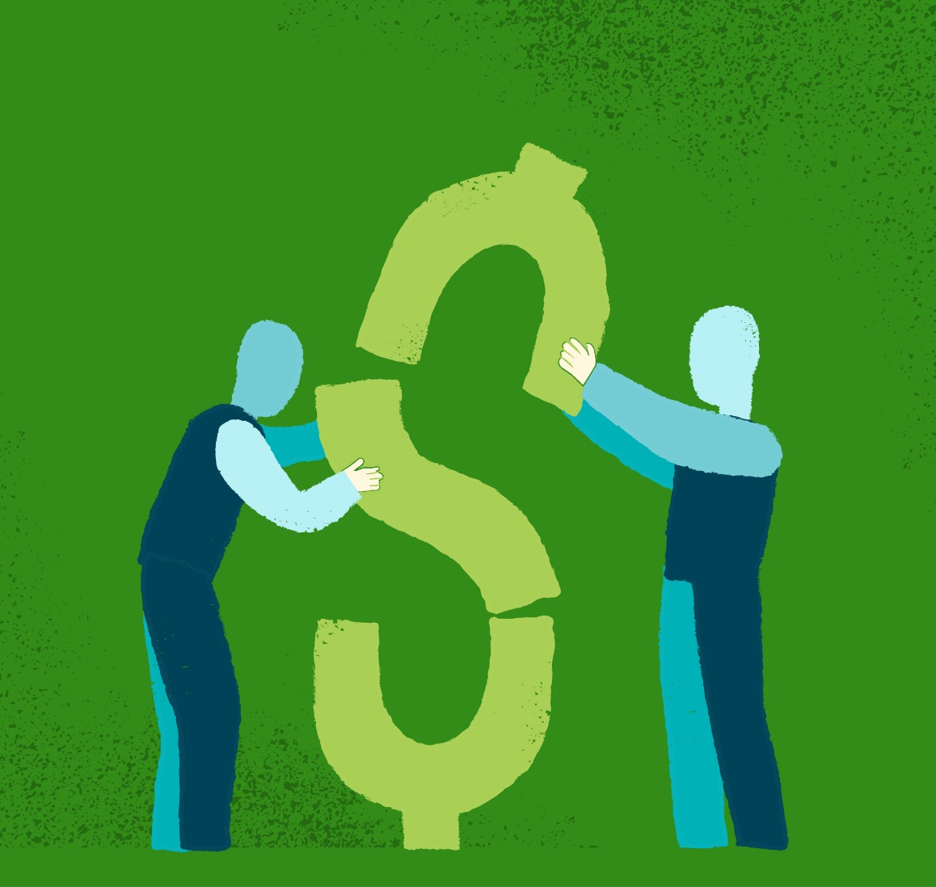

Project Overview
SplitWise is a comprehensive expense management platform designed to simplify the way users handle their personal and group finances. With a user-friendly interface, SplitWise enables users to sign up, add friends, and effortlessly log expenses, whether shared among a group or involving individual friends. The system provides a transparent overview of balances, facilitating easy debt settlement and accurate tracking of financial interactions.
2

Slide 3



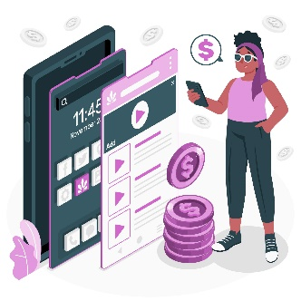


Features
User Management
Expense Tracking
Sign Up
Login
List of Users
Add expenses
Multiple user shared Expense
One user and one friend shared expense
Friend Management
Balance Tracking
Add Friend
Remove Friend
List of Friends
Calculate and display balances
Shows who paid how much
Shows how much each person owes
3

Slide 4

Code and Design Smells
1 | Inconsistent Naming
2 | God Class
3 | Duplicate Code
1 | Rigidity
2 | Fragility
3 | Viscosity
4 | Data Clumps
5 | Black Sheep
6 | Shotgun Surgery
4 | Immobility
5 | Needless Complexity
6 | Opacity
4

Slide 5
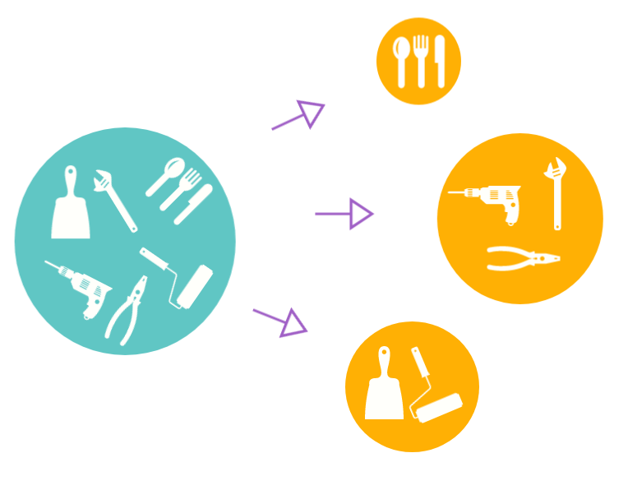
Application of SOLID
1. Single Responsibility Principle (SRP):
The Main class of un-refactored code had multiple responsibilities such as managing the user interface, handling user input, and interacting with user-related functionalities like login, sign-up, etc. So, I Separated these responsibilities into distinct classes to ensure each class has a single responsibility. In my refactored code:
User class
Expenses class
Operation classes (GroupExpenses, NonGroupExpenses, GroupOperations, NonGroupOperations, ManageFriends, UserMenu, SignUp, Login, HomeMenu)
5

Slide 6

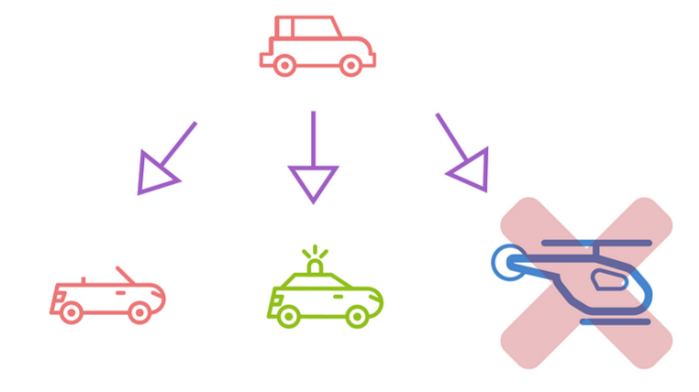
2. Open/Closed Principle (OCP):
In the Main class of un-refactored code, the menu options and related logic are hardcoded within the methods. Adding a new menu option or modifying existing behavior would require changing the existing code. After Refactoring, I can easily introduce new methods in my code.
IExpenses interface
Operational Classes
3. Liskov Substitution Principle (LSP):
I didn’t make any use of LSP in my code.
6

Slide 7
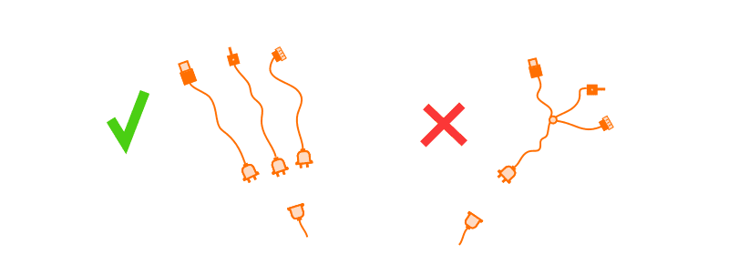
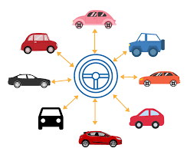
4. Interface Segregation Principle (ISP):
The IExpenses interface is used to segregate methods related to expenses. Classes that need to handle expenses implement this interface, and they only need to provide implementations for the methods relevant to their responsibilities (addExpenses() and balances()).
5. Dependency Inversion Principle (DIP):
The Main class of un-refactored code is tightly coupled, where direct instantiation of concrete classes like Login, SignUp, UserMenu, etc., is happening. So, I consider using dependency injection to decouple classes and promote better testability and flexibility.
High level Modules are depending on User class which is abstraction instead of concrete classes.
High level modules (GroupOperations, NonGroupOperations) are depending on IExpenses interface which is also an abstraction.
7

Slide 8
Thank You

